Slide 1
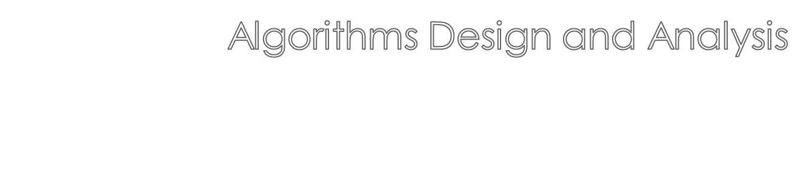


Slide 2

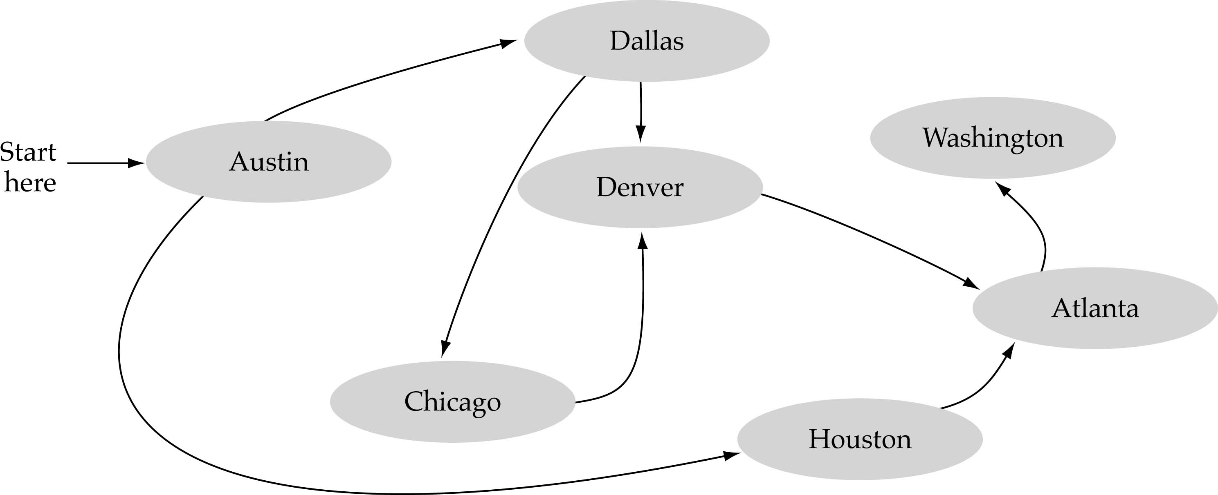
A data structure that consists of a set of nodes (vertices) and a set of edges that relate the nodes to each other
The set of edges describes relationships among the vertices

Slide 3

A graph G is defined as follows:
G=(V,E)
V(G): a finite, nonempty set of vertices
E(G): a set of edges (pairs of vertices)

Slide 4

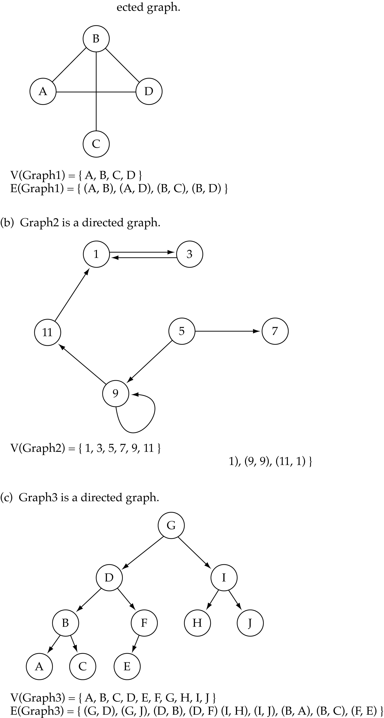
When the edges in a graph have no direction, the graph is called undirected

Slide 5

When the edges in a graph have a direction, the graph is called directed (or digraph)
Warning: if the graph is directed, the order of the vertices in each edge is important !!
E(Graph2) = {(1,3) (3,1) (5,9) (9,11) (5,7)

Slide 6

Trees are special cases of graphs!!

Slide 7

Adjacent nodes: two nodes are adjacent if they are connected by an edge
Path: a sequence of vertices that connect two nodes in a graph
Complete graph: a graph in which every vertex is directly connected to every other vertex
5 is adjacent to 7
7 is adjacent from 5

Slide 8
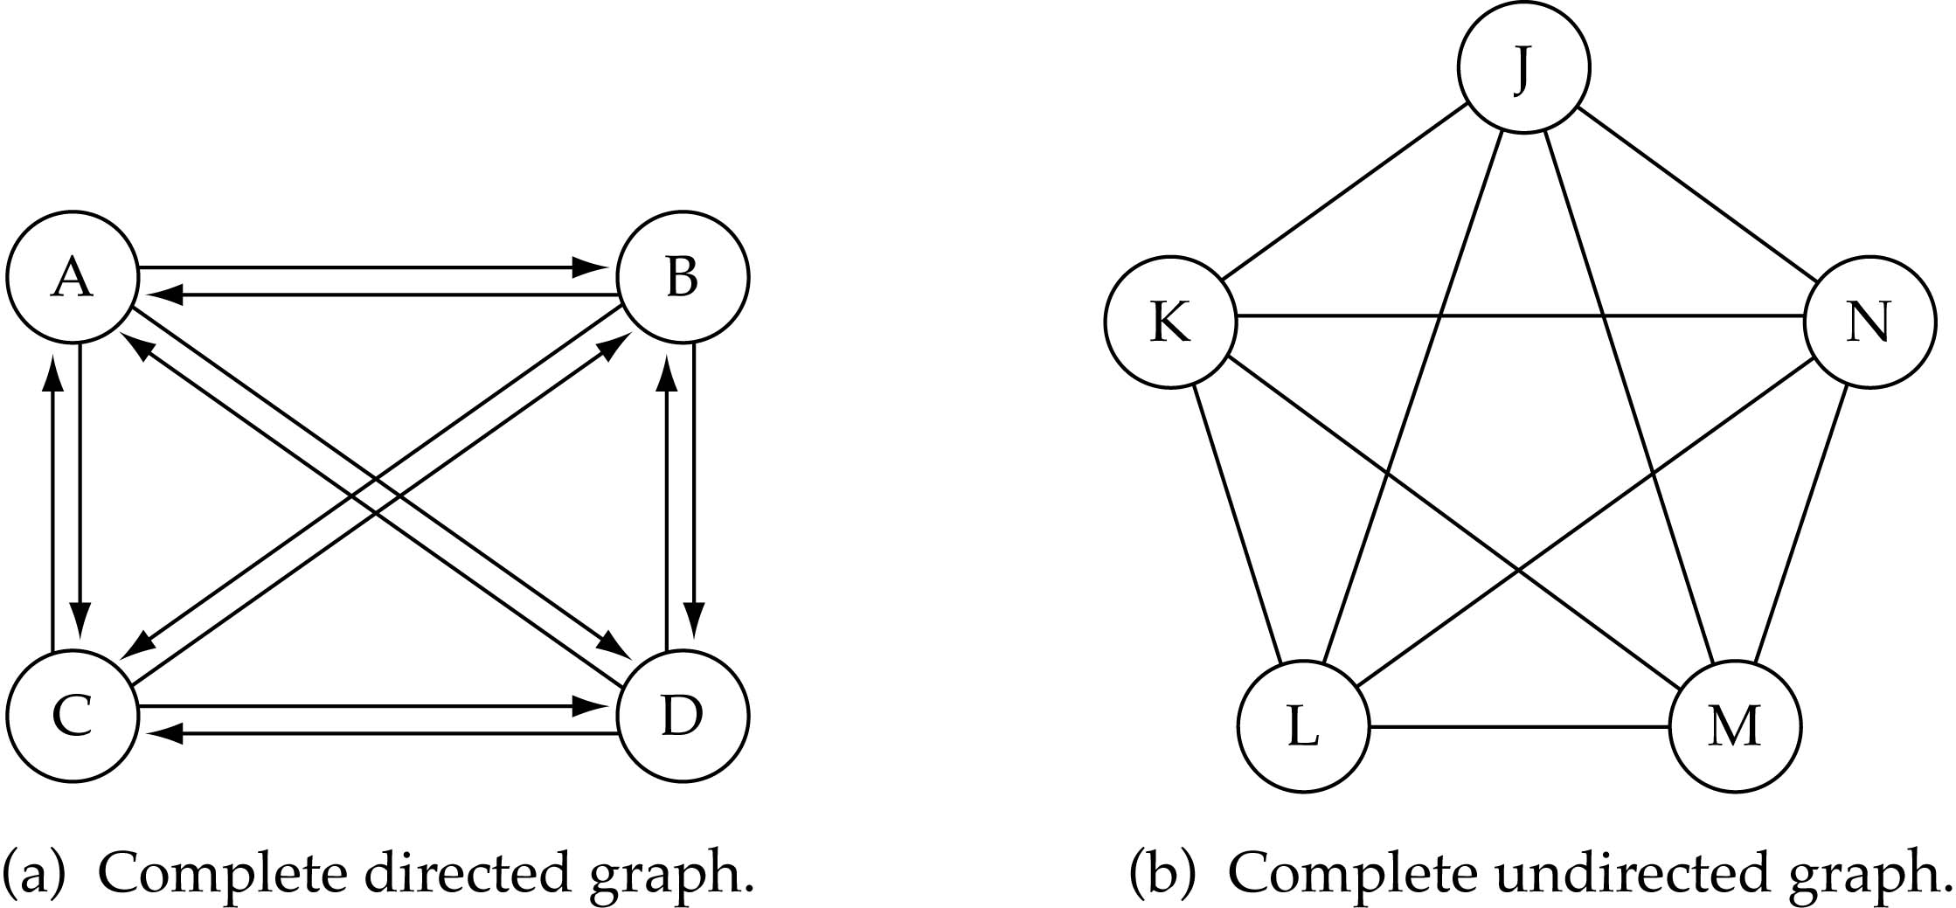
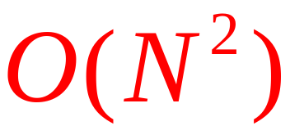
What is the number of edges in a complete directed graph with N vertices?
N * (N-1)

Slide 9

What is the number of edges in a complete undirected graph with N vertices?
N * (N-1) / 2

Slide 10
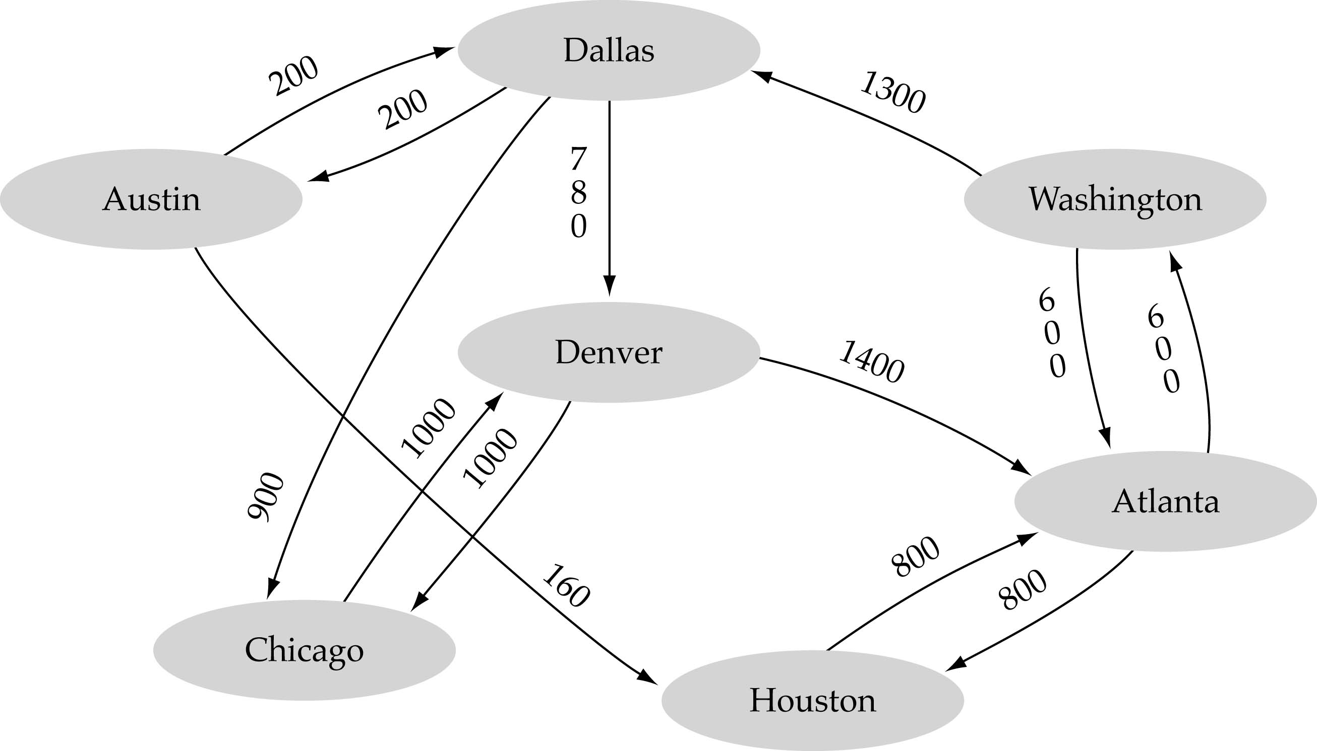
Weighted graph: a graph in which each edge carries a value

Slide 11

Array-based implementation
  A 2D array (adjacency matrix) is used to represent the edges

Slide 12

Linked-list implementation
  A 1D array is used to represent the vertices
  A list is used for each vertex v which contains the vertices which are adjacent from v (adjacency list)

Slide 13

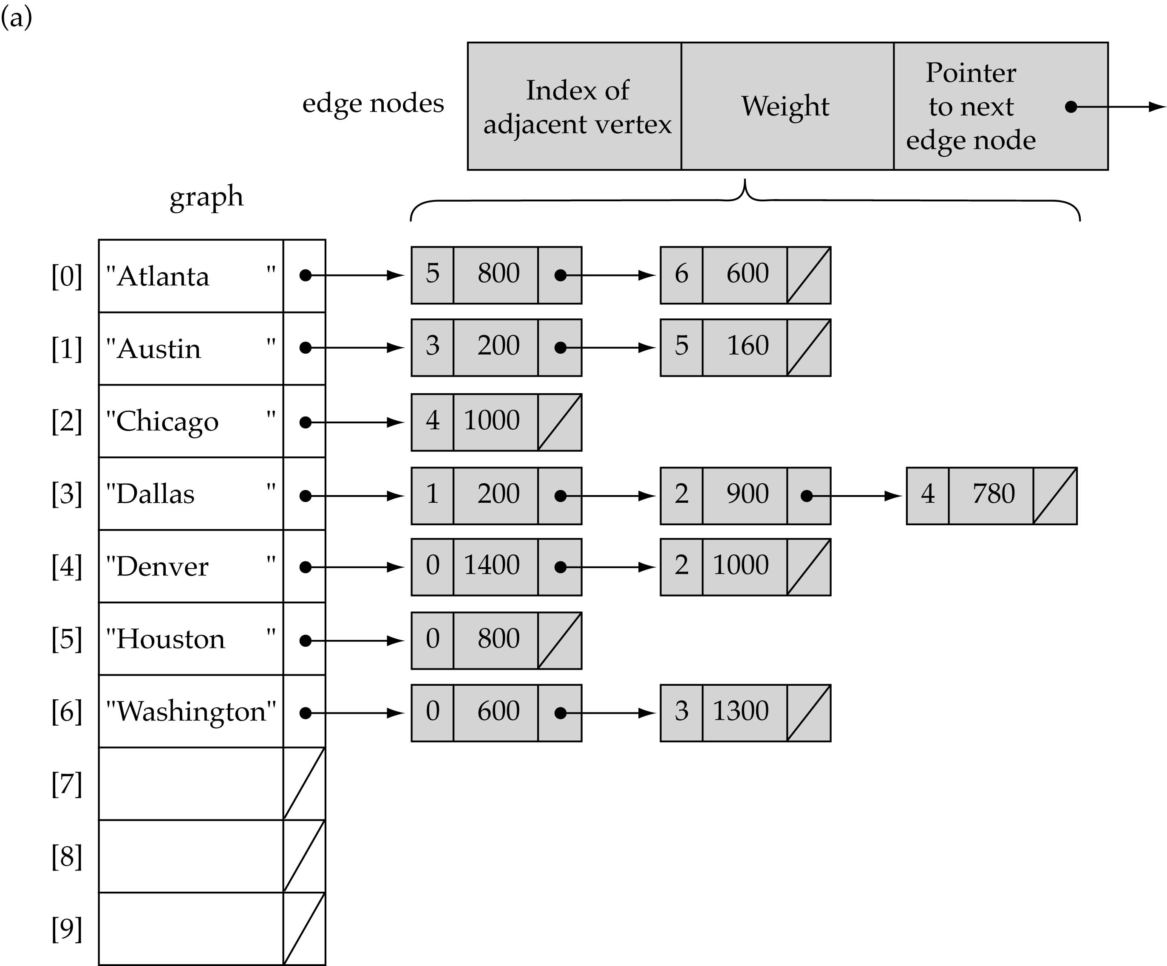

Slide 14

Adjacency matrix
  Good for dense graphs --|E|~O(|V|²)
  Memory requirements: O(|V| + |E| ) = O(|V|² )
  Connectivity between two vertices can be tested quickly
Adjacency list
  Good for sparse graphs -- |E|~O(|V|)
  Memory requirements: O(|V| + |E|)=O(|V|)
  Vertices adjacent to another vertex can be found quickly

Slide 15

Problem: find a path between two nodes of the graph (e.g., Austin and Washington)
Methods: Depth-First-Search (DFS) or Breadth-First-Search (BFS)

Slide 16

What is the idea behind DFS?
  Travel as far as you can down a path
  Back up as little as possible when you reach a "dead end" (i.e., next vertex has been "marked" or there is no next vertex)
DFS can be implemented efficiently using a stack

Slide 17

Each vertex is visited and adjacency list of each vertex is also scanned.
So total time is O(V + E)

Slide 18
DFS(G)
1 for each vertex u ∈ V[G]
2 u.color ← WHITE
3 u.π← NIL
4 time ← 0
5 for each vertex u ∈ V[G]
6 if u.color == WHITE
7 DFS-VISIT(G, u)
DFS-VISIT(G, u)
1 u.color ← GRAY
2 time ← time+1
3 u.d ← time
4 for each v ∈ Adj[u]
5 if v.color == WHITE
6 v.π ← u
7 DFS-VISIT(G, v)
8 u.color← BLACK
9 time = time +1
10 u.f = time

Slide 19

Adjacency List
A->B,E,F
B->A,C,F
C->B,D,G
D->C,G,H
E->A,F,I
F->A,B,E,I
G->C,D,J,K,L
H->D,L
I->E,F,J,M,N
J->G,I,K
K->G,J,N,O
L->G,H,P
M->I,N
N->I,M,K
O->K,P
P->L,O
A
B
C
D
E
F
G
H
I
J
K
L
M
N
O
P

Slide 20


Adjacency List
A->B,E,F
B->A,C,F
C->B,D,G
D->C,G,H
E->A,F,I
F->A,B,E,I
G->C,D,J,K,L
H->D,L
I->E,F,J,M,N
J->G,I,K
K->G,J,N,O
L->G,H,P
M->I,N
N->I,M,K
O->K,P
P->L,O
A
B
C
D
E
F
G
H
Dead end Backtrack
I
J
K
L
M
N
O
P

Slide 21
Adjacency List
A->B,E,F
B->A,C,F
C->B,D,G
D->C,G,H
E->A,F,I
F->A,B,E,I
G->C,D,J,K,L
H->D,L
I->E,F,J,M,N
J->G,I,K
K->G,J,N,O
L->G,H,P
M->I,N
N->I,M,K
O->K,P
P->L,O
A
B
C
D
E
F
G
H
I
J
K
L
M
N
O
P

Slide 22

Adjacency List
A->B,E,F
B->A,C,F
C->B,D,G
D->C,G,H
E->A,F,I
F->A,B,E,I
G->C,D,J,K,L
H->D,L
I->E,F,J,M,N
J->G,I,K
K->G,J,N,O
L->G,H,P
M->I,N
N->I,M,K
O->K,P
P->L,O
A
B
C
D
E
F
G
H
End of Traversal
I
J
K
L
M
N
O
P

Slide 23

What is the idea behind BFS?
  Look at all possible paths at the same depth before you go at a deeper level
  Back up as far as possible when you reach a "dead end" (i.e., next vertex has been "marked" or there is no next vertex)

Slide 24

BFS(G, s)
1 for each vertex u ∈ V[G] − {s}
2 u.color ← WHITE
3 u.d←∞
4 u.π← NIL
5 s.color ← GRAY
6 s.d ← 0
7 s.π ← NIL
8 Q ← ∅
9 ENQUEUE(Q, s)
10 while Q != ∅
11 u ← DEQUEUE(Q)
12 for each v ∈ Adj[u]
13 if v.color= WHITE
14 v.color ← GRAY
15 v.d← u.d + 1
16 v.π← u
17 ENQUEUE(Q, v)
18 u.color← BLACK

Slide 25


Adjacency List
Level 1
A->B,E,F
B->A,C,F
C->B,D,G
D->C,G,H
E->A,F,I
F->A,B,E,I
G->C,D,J,K,L
H->D,L
I->E,F,J,M,N
J->G,I,K
K->G,J,N,O
L->G,H,P
M->I,N
N->I,M,K
O->K,P
P->L,O
A
B
C
D
E
F
G
H
I
J
K
L
M
N
O
P

Slide 26
Adjacency List
Level 2
A->B,E,F
B->A,C,F
C->B,D,G
D->C,G,H
E->A,F,I
F->A,B,E,I
G->C,D,J,K,L
H->D,L
I->E,F,J,M,N
J->G,I,K
K->G,J,N,O
L->G,H,P
M->I,N
N->I,M,K
O->K,P
P->L,O
A
B
C
D
E
F
G
H
I
J
K
L
M
N
O
P

Slide 27
Adjacency List
Level 3
A->B,E,F
B->A,C,F
C->B,D,G
D->C,G,H
E->A,F,I
F->A,B,E,I
G->C,D,J,K,L
H->D,L
I->E,F,J,M,N
J->G,I,K
K->G,J,N,O
L->G,H,P
M->I,N
N->I,M,K
O->K,P
P->L,O
A
B
C
D
E
F
G
H
I
J
K
L
M
N
O
P

Slide 28
Adjacency List
Level 4
A->B,E,F
B->A,C,F
C->B,D,G
D->C,G,H
E->A,F,I
F->A,B,E,I
G->C,D,J,K,L
H->D,L
I->E,F,J,M,N
J->G,I,K
K->G,J,N,O
L->G,H,P
M->I,N
N->I,M,K
O->K,P
P->L,O
A
B
C
D
E
F
G
H
I
J
K
L
M
N
O
P

Slide 29
Adjacency List
Level 5
A->B,E,F
B->A,C,F
C->B,D,G
D->C,G,H
E->A,F,I
F->A,B,E,I
G->C,D,J,K,L
H->D,L
I->E,F,J,M,N
J->G,I,K
K->G,J,N,O
L->G,H,P
M->I,N
N->I,M,K
O->K,P
P->L,O
A
B
C
D
E
F
G
H
I
J
K
L
M
N
O
P

Slide 30
Adjacency List
Finally
A->B,E,F
B->A,C,F
C->B,D,G
D->C,G,H
E->A,F,I
F->A,B,E,I
G->C,D,J,K,L
H->D,L
I->E,F,J,M,N
J->G,I,K
K->G,J,N,O
L->G,H,P
M->I,N
N->I,M,K
O->K,P
P->L,O
A
B
C
D
E
F
G
H
I
J
K
L
M
N
O
P

Slide 31

The operations of enqueuing and dequeuing takes O(1).
So total queue operation is O(V)
For each vertex adjacency list is scanned, so total time spent in scanning adjacencies is O(E)
Total time is O(V + E)

Slide 32


